Slide 1
DEVELOPMENT OF MILLIMETER WAVE STANDARDS

Slide 2
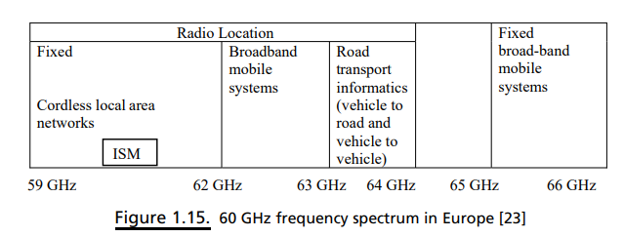
DEVELOPMENT OF MILLIMETER WAVE STANDARDS
Europe
The European Telecommunications Standards Institute (ETSI) and the European Conference of Postal and Telecommunications Administrations (CEPT) have been working closely to establish a legal framework for the deployment of unlicensed 60 GHz devices
In general, the 59–66 GHz band has been allocated for mobile services without a specific decision on the regulations, as shown in Figure 1.15.
In Recommendation T/R 22–03, the CEPT provisionally recommended the use of the 54.25–66 GHz band for terrestrial and fixed mobile systems

Slide 3
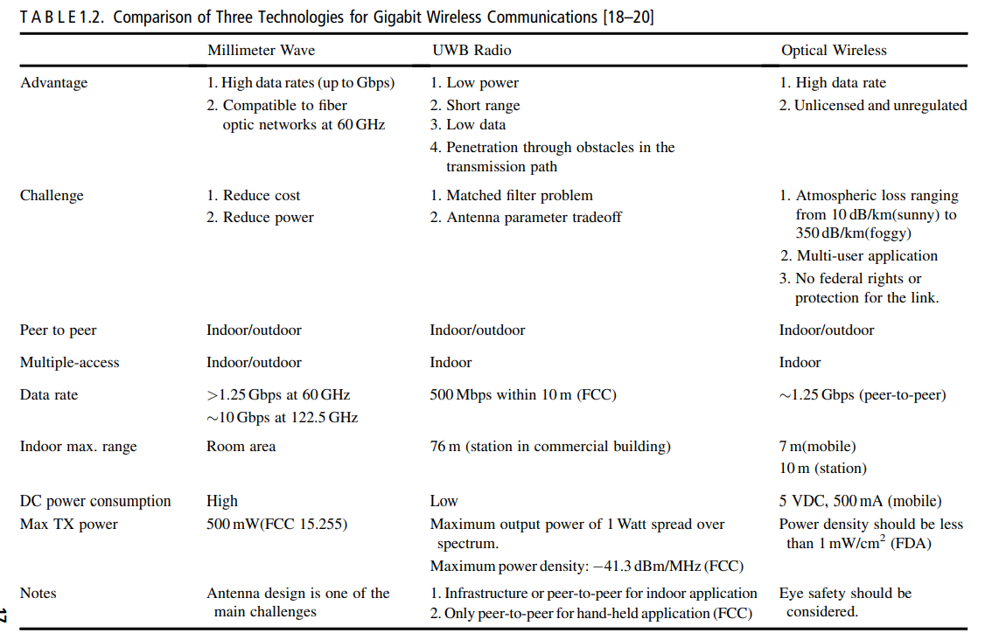

Slide 4
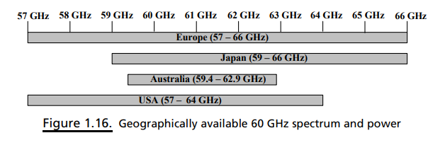
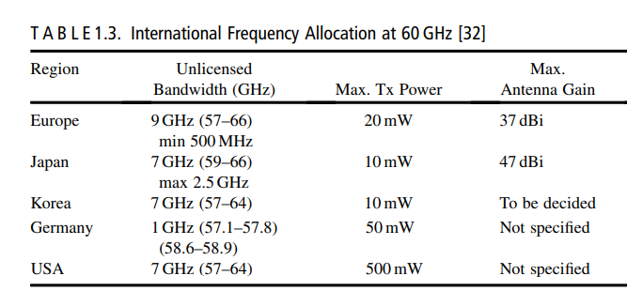
The ERC also considered the use of the 57–59 GHz band for fixed services without requiring frequency planning.
Later, the Electronic Communications Committee (ECC) of CEPT recommended the use of point-to-point fixed services in the 64–66 GHz band .
A few years ago, ETSI proposed 60 GHz regulations to be considered by the ECC of the European Conference of Post and Telecommunications Administrations for WPAN applications .
Under this proposal, a 9-GHz unlicensed spectrum has been allocated for 60 GHz operation.
The frequency band being considered is 57–66 GHz. The spectrum allocation is shown in Figure 1.16

Slide 5
United States
In terms of the power limits, the FCC rules allow emissions with an average power density of 9 mW/cm² at 3 m and a maximum power density of 18 mW/cm2 at a range of 3 m from the radiating source.
These data translate to an average equivalent isotropic radiated power (EIRP) and a maximum EIRP of 40 dBm and 43 dBm, respectively.
The FCC also specified a total maximum transmission power of 500 mW for an emission bandwidth greater than 100 MHz.
After taking the RF safety issues into account, the maximum transmission power is limited to 10 dBm.
Furthermore, each transmitter must transmit at least one transmitter identification signal within a one-second interval of the signal transmission.
It is important to note that the 60 GHz regulations in Canada, which are regulated by Industry Canada Spectrum Management and Telecommunications (IC-SMT) [33], harmonize with the United States

Slide 6
the FCC announced that the frequency bands found at 71–76 GHz, 81–86 GHz, and 92–95 GHz were available for wireless applications [
FCC chairman Michael Powell heralded the ruling as opening a “new frontier” in commercial services and products for the U.S. users .
The allocation provides the opportunity for a broad range of new products and services, including high-speed, point-to-point WLANs and broadband Internet access at gigabit data rates and beyond.
Japan
The Ministry of Public Management, Home Affairs, Posts, and Telecommunications (MPHPT) of Japan issued 60 GHz radio regulations for unlicensed utilization of the 59–66 GHz band
However, the 54.25–59 GHz band is allocated for licensed use. The maximum transmission power for this unlicensed use is limited to 10 dBm, with a maximum allowable antenna gain of 47 dBi.
Unlike the arrangements in North America, the Japanese regulations specified that the maximum transmission bandwidth must not exceed 2.5 GHz

Slide 7
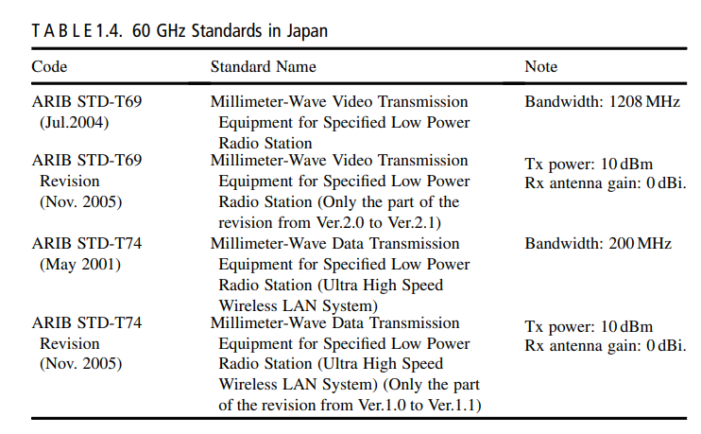

Slide 8
Applications of mmWave Communication

Slide 9
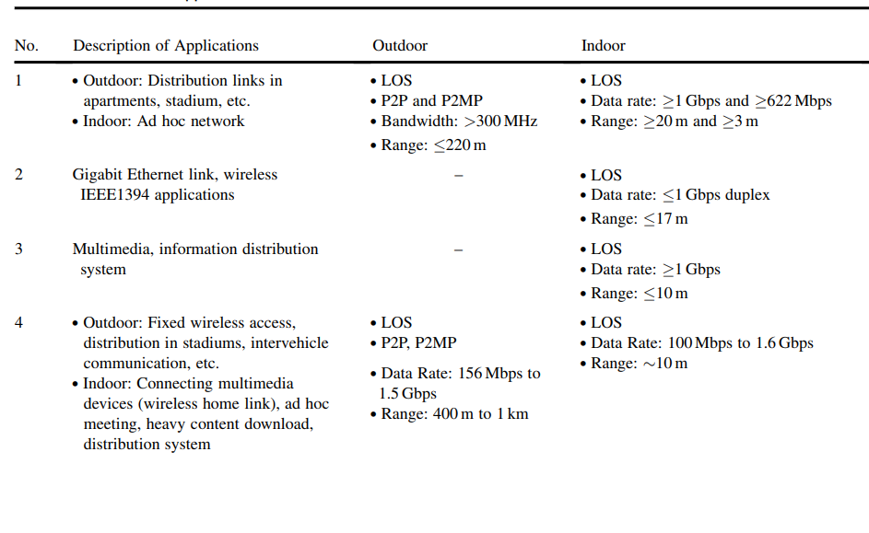
Applications

Slide 10
